Slide 1

Competitive Programming From Problem 2 Solution in O(1)
P
T
H
I
N
K
F
A
S
T
S
C++: Pointers 2
Mostafa Saad Ibrahim
PhD Student @ Simon Fraser University

Slide 2
Dynamic Array Allocation
Imagine we have software for company
We have many employees..say 1000
But, they may increase from time to time
But, so far we know about static array.
Should we define something big?
E.g. String employee_name[100000];
But this is waste of memory!
Can’t we have array with dynamic size?

Slide 3
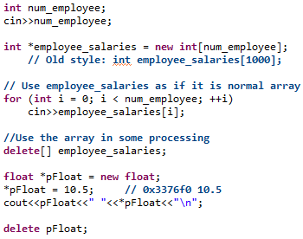
New / Delete operators
New allows us to create dynmaically array in memory and Delete to release this memory

Slide 4
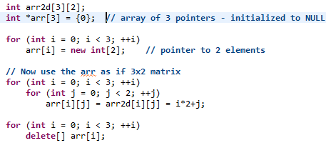
Array of pointers
arr[0] 0x200
arr 0x5
0 | 1
arr[1] 0x421
2 | 3
Consective memory block of 6 elements
arr2d[1][1] is 1 * 2 + 1 th element
arr[2] 0x667
arr2d 0x17
0 | 1 | 2 | 3 | 4 | 5
4 | 5
Pointers are the consective NOT data
Each pointer data are consective)

Slide 5
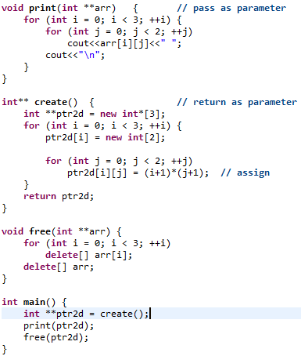
Pointer to Pointer
In similar fashion
Do int *** ptrArr;
Again
2d array in memory
NOT as
Point to pointers
E.g. You shouldn’t pass 2D array to print method

Slide 6
Memory Leaks
The worst thing happens in real life is memory leak
Forget or do buggy code that doesn’t free memory
Imagine function each time is called creates 10^6 numbers but don’t free
Each time is called, memory grow up
Then machine stuck => whole memory reserved
Some tools in real life to detect leaks helps
Revise your code very well
Check task manager memory of process
Or use nowadays smart pointers ☺

Slide 7
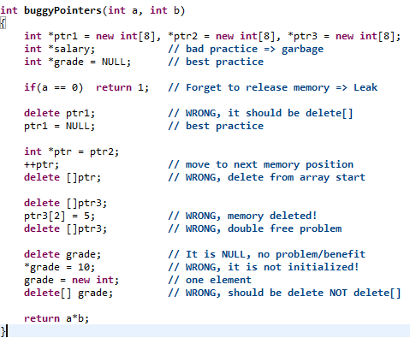
Common Mistakes

Slide 8
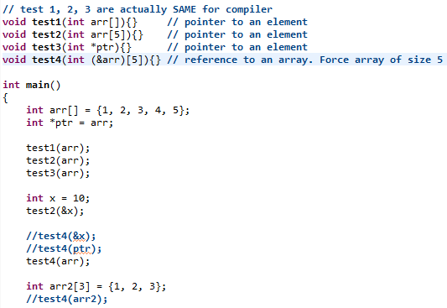
Passing arrays / pointers
Why int arr[] same as int * ?
Because we know in both cases
next element is after 4 bytes

Slide 9

Passing arrays / pointers
But WHY in 2d array case we need to pass 2nd dimension?
Then how to know cell address in memory?!!!!
Where is arr[2][3]?
It exist at 2 * 10 + 3 –th element starting from array start
===================
Then How print (int ppTrr**) know the address of ppTrr[2][3]!!
Recall: Pointers now are the consective elements in the array not the data
ppTrr[1] is after first element ppTrr[0]
from ppTrr[1] we can get this pointer elements normally

Slide 10
Standards, Compilers and Architectures
C++ Standard
ISO meets and determines new features. Versions are such as 2003 (C++03) and 2011 (C++11)
Compilers
Compilers implement the standard
Sometimes NOT every feature. Some times allowed non standard features
Architectures
There are different processors and instruction sets (e.g. X86, RISC..etc). Endianess issue matters
Learn from standards NOT from compilers/run time behaviour.
Something that compiles doesn’t mean it is correct. Reverse is same
Something that works in run time, not necessary right ☺

Slide 11

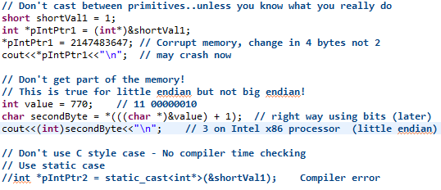
Shooting yourself in the foot

Slide 12
Others
Placement new Operator
Kind of memory management by yourself
You can use allocated memory to create object inside it INSTEAD of using new memory
Personal: Better not to use ☺ or be very careful
alloca
Pointers memory are in stack NOT heap
Personal: Better not to use ☺ or be very careful

Slide 13
تم بحمد الله
علمكم الله ما ينفعكم
ونفعكم بما تعلمتم
وزادكم علماً

